Slide 1
Face Recognition using PCA
Design a classifier to recognize face image
Team Cortes
August 2017

Slide 2












The problem:
WHO is this?

Slide 3
The flow of data:
Data Collection
Test and training data split
Pick the winning model !
PCA
Modeling
Linear, Guassian, Ensemble etc.
Evaluation matrix
Black arrow: flow of training data
Red arrow: flow of testing data

Slide 4
Method and Results
Data collection:
Collect face images using opencv package
100 images per class, 6 classes

Slide 5
Method and Results
Test and Training data split
Training data: 75% data (444 samples)
Testing data: 25% data (147 samples)
Randomized samples
Sample counts in each class of training data:
(class_id: sample counts)
0: 68, 1: 74, 2: 73, 3: 79, 4: 80, 5: 70

Slide 6
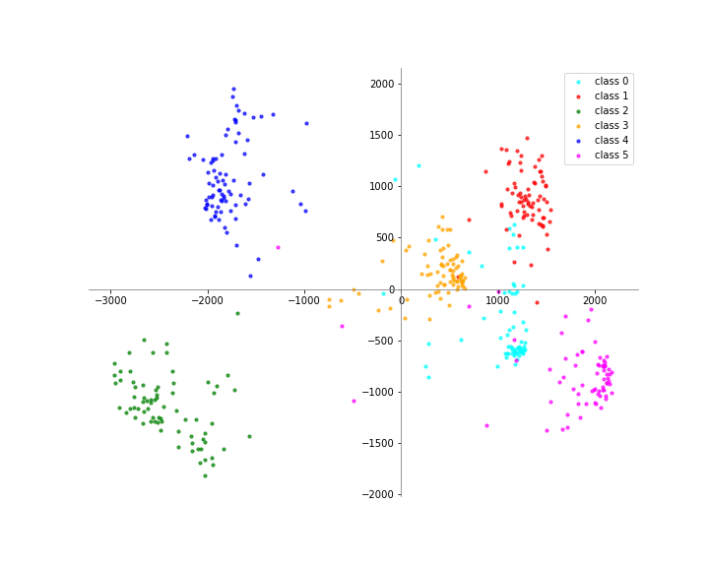
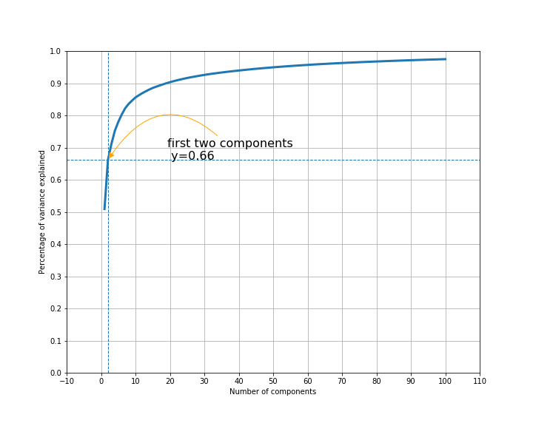
Method and Results
PCA on training data (2500 -> 2 dims)

Slide 7
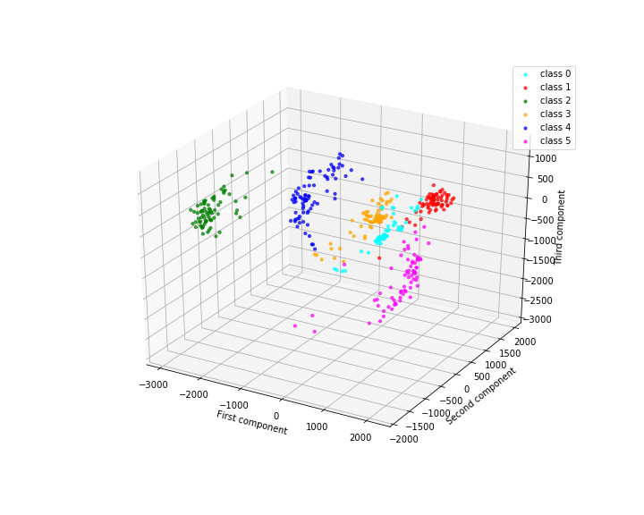
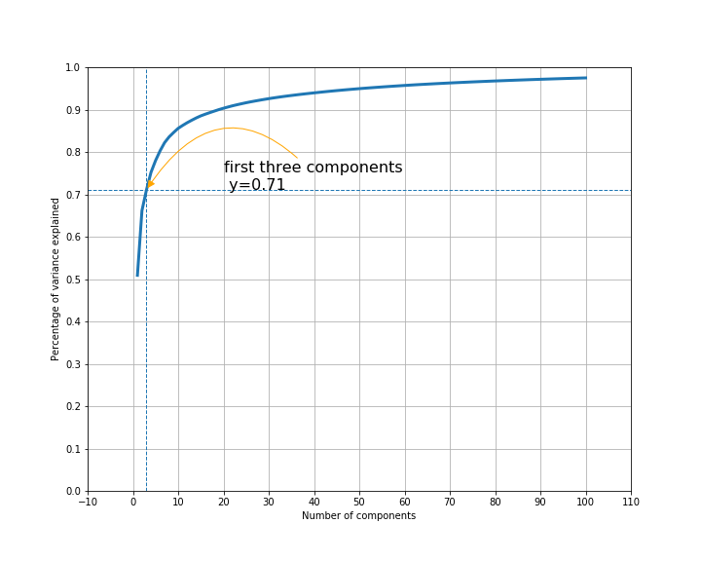
Method and Results
PCA on training data (2500 -> 3 dims)

Slide 8
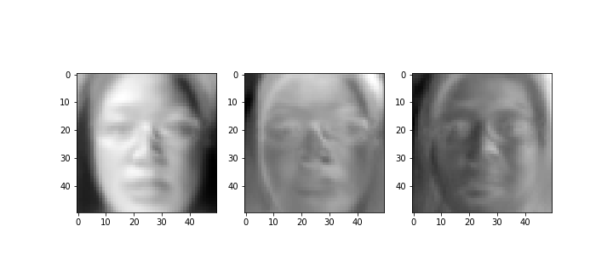
Method and Results
Eigen faces

Slide 9
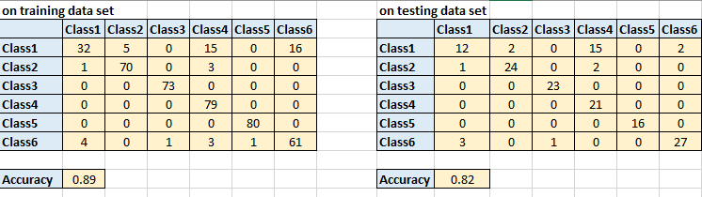
Method and Results
Gaussian/Bayesian Model using 2PC
Confusion Matrix

Slide 10
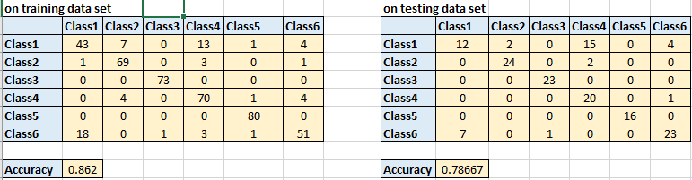
Method and Results
Gaussian/Bayesian Model using 3PC
Confusion Matrix

Slide 11
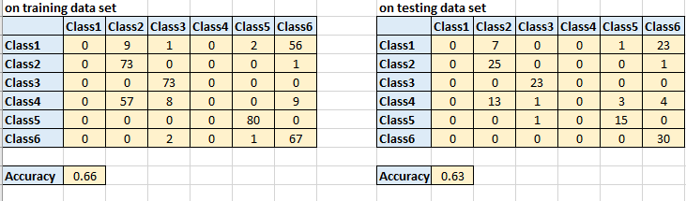
Method and Results
Linear Model using 2PC
Confusion Matrix

Slide 12
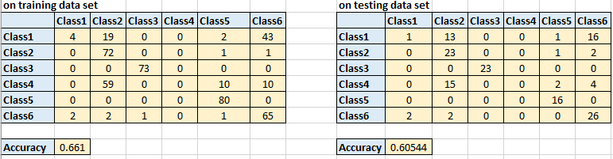
Method and Results
Linear Model using 3PC
Confusion Matrix

Slide 13
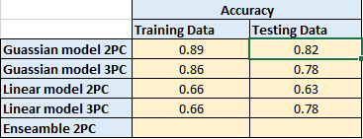
Method and Results
Performance comparison

Slide 14
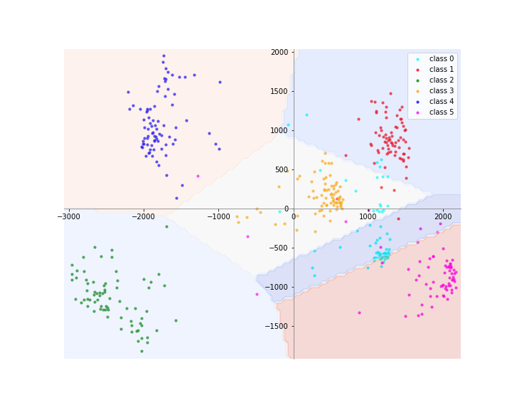
Method and Results
Decision boundary (2D Gaussian)

Slide 15
Discussion
Factors affect model performance: the effect of lighting on prediction
Caveats: unexpected male and female separation.

Slide 16
Acknowledgements
Team of Cortes
Priyanka Deo
Weiya Jiang
Nicolas Loffreda
Krupa Masilamani
Mukul Sharma
Laura Ye
Special thanks to our teacher:
Shashidhar Sathyanarayana

